Slide 1
Java Language Features and Syntax
Name : Shrushti Vishwambhar Pawar

Slide 2
What is Java
Java is a high-level, class-based, object-oriented programming language that is
designed to have as few implementation dependencies as possible.
It is a general-purpose programming language intended to let programmers write once
, run anywhere (WORA),] meaning that compiled Java code can run on all platforms
that support Java without the need to recompile.
Java applications are typically compiled to bytecode that can run on any Java virtual
machine (JVM) regardless of the underlying computer architecture.
The syntax of Java is similar to C and C++, but has fewer low-level facilities than either
of them.
The Java runtime provides dynamic capabilities (such as reflection and runtime code
modification) that are typically not available in traditional compiled languages.

Slide 3
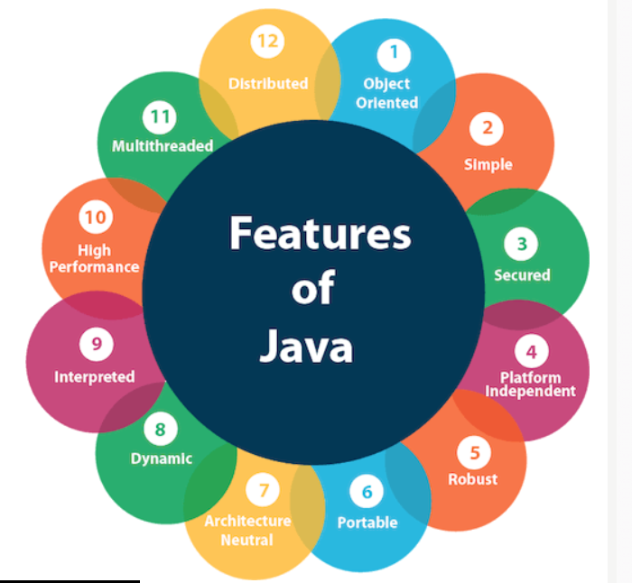
Features of Java
The primary objective of Java programming language creation was to make it portable, simple and secure programming language.
Apart from this, there are also some excellent features which play an important role in the popularity of this language.
The features of Java are also known as Java buzzwords.
Simple
Object-Oriented
Portable
Platform independent
Secured

Slide 4
java Syntax
The syntax of Java is largely influenced by C++ and C. Unlike C++, which combines the syntax for structured, generic, and object-oriented programming, Java was built almost exclusively as an object-oriented language.
All code is written inside classes, and every data item is an object, with the exception of the primitive data types, (i.e. integers, floating-point numbers, boolean values, and characters), which are not objects for performance reasons. Java reuses some popular aspects of C++
Hello world example
public class Main {
public static void main(String[] args) {
System.out.println("Hello World!"); // Prints the string to the console.
}
}

Slide 5
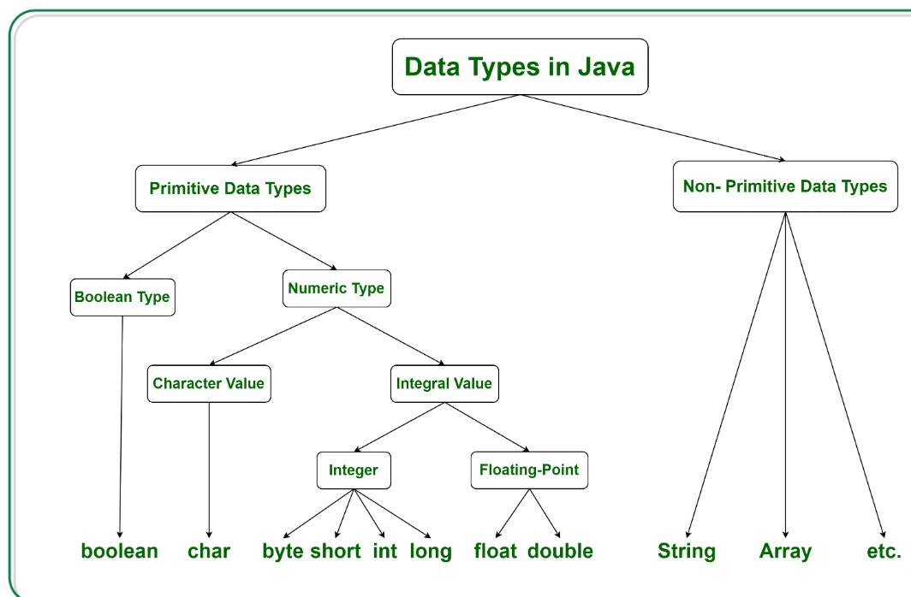
Data Types in Java
Primitive Data Type
Non-Primitive Data Type or Object Data type

Slide 6
Primitive Data Type
1. Boolean Data Type
Syntax:
boolean booleanVar;
2. Byte Data Type
Syntax:
byte byteVar;
3. Short Data Type
Syntax:
short shortVar;
4. Integer Data Type
Syntax:
int intVar;

Slide 7
5. Long Data Type
Syntax:
long longVar;
6. Float Data Type
Syntax:
float floatVar;
7. Char Data Type
Syntax:
char charVar;

Slide 8
Non-Primitive Data Type or Reference Data Types
1. Strings
Strings are defined as an array of characters.
Syntax: Declaring a string
<String_Type> <string_variable> = “<sequence_of_string>”;
2. Class
A class is a user-defined blueprint or prototype from which objects are created. Modifiers: A class can be public or has default access. Refer to access specifiers for classes or interfaces in Java
Modifiers: A class can be public or has default access. Refer to access specifiers for classes or interfaces in Java
Class name: The name should begin with an initial letter (capitalized by convention).
Superclass(if any): The name of the class’s parent (superclass), if any, preceded by the keyword extends. A class can only extend (subclass) one parent.
Body: The class body is surrounded by braces, { }

Slide 9
3. Object
An Object is a basic unit of Object-Oriented Programming and represents real-life entities. A typical Java program creates many objects, which as you know, interact by invoking methods. An object consists of :
State: It is represented by the attributes of an object. It also reflects the properties of an object.
Behavior: It is represented by the methods of an object. It also reflects the response of an object to other objects.
Identity: It gives a unique name to an object and enables one object to interact with other objects.
4. Interface
Like a class, an interface can have methods and variables, but the methods declared in an interface are by default abstract (only method signature, no body).
Interfaces specify what a class must do and not how. It is the blueprint of the class.
5. Array
An Array is a group of like-typed variables that are referred to by a common name. Arrays in Java work differently than they do in C/C++. The following are some important points about Java arrays.

Slide 10
Control Flow in Java
Java compiler executes the code from top to bottom. The statements in the code are executed according to the order in which they appear. However, Java provides statements that can be used to control the flow of Java code. Such statements are called control flow statements. It is one of the fundamental features of Java, which provides a smooth flow of program.
Java provides three types of control flow statements.
Decision Making statements
if statements
switch statement
Loop statements
do while loop
while loop
for loop
for-each loop
Jump statements
break statement
continue statement

Slide 11
Exception handling
When executing Java code, different errors can occur: coding errors made by the programmer, errors due to wrong input, or other unforeseeable things.
When an error occurs, Java will normally stop and generate an error message. The technical term for this is: Java will throw an exception (throw an error).
Java try and catch
Finally
The throw keyword

Slide 12
Java try and catch
The try statement allows you to define a block of code to be tested for errors while it is being executed.
The catch statement allows you to define a block of code to be executed, if an error occurs in the try block.
The try and catch keywords come in pairs:
Syntax
try {
// Block of code to try
}
catch(Exception e) {
// Block of code to handle errors
}

Slide 13
Finally
The finally statement lets you execute code, after try...catch, regardless of the result:
Example
public class Main {
public static void main(String[] args) {
try {
int[] myNumbers = {1, 2, 3};
System.out.println(myNumbers[10]);
} catch (Exception e) {
System.out.println("Something went wrong.");
} finally {
System.out.println("The 'try catch' is finished.");
}
}
The output will be:
Something went wrong.
The 'try catch' is finished.

Slide 14
The throw keyword
The throw statement is used together with an exception type. There are many exception types available in Java: ArithmeticException, FileNotFoundException, ArrayIndexOutOfBoundsException, SecurityException, etc:
Example
Throw an exception if age is below 18 (print "Access denied"). If age is 18 or older, print "Access granted":
public class Main {
static void checkAge(int age) {
if (age < 18) {
throw new ArithmeticException("Access denied - You must be at least 18 years old.");
}

Slide 15
else {
System.out.println("Access granted - You are old enough!");
}
}
public static void main(String[] args) {
checkAge(15); // Set age to 15 (which is below 18...) }
The output will be:
Exception in thread "main" java.lang.ArithmeticException: Access denied - You must be at least 18 years old.
at Main.checkAge(Main.java:4)
at Main.main(Main.java:12)

